Slide 1
Algebraic
Methods
Twitter: @Owen134866
www.mathsfreeresourcelibrary.com

Slide 2


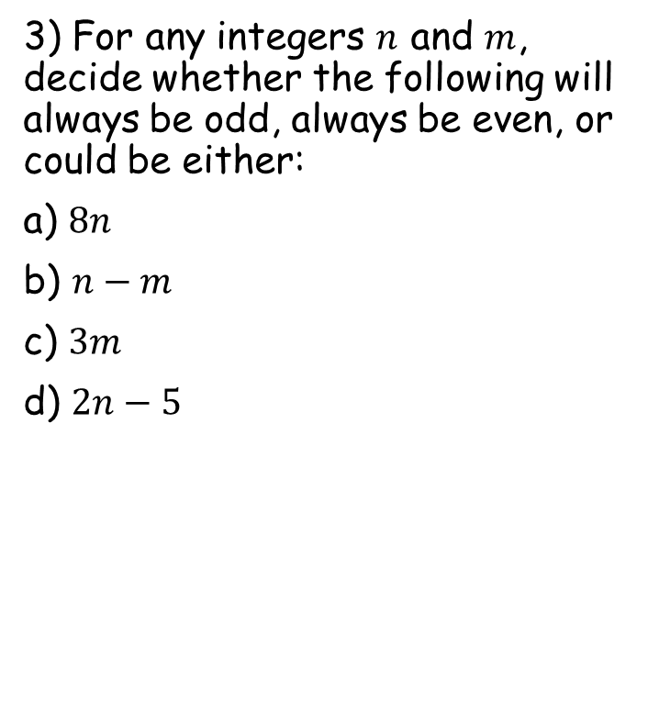


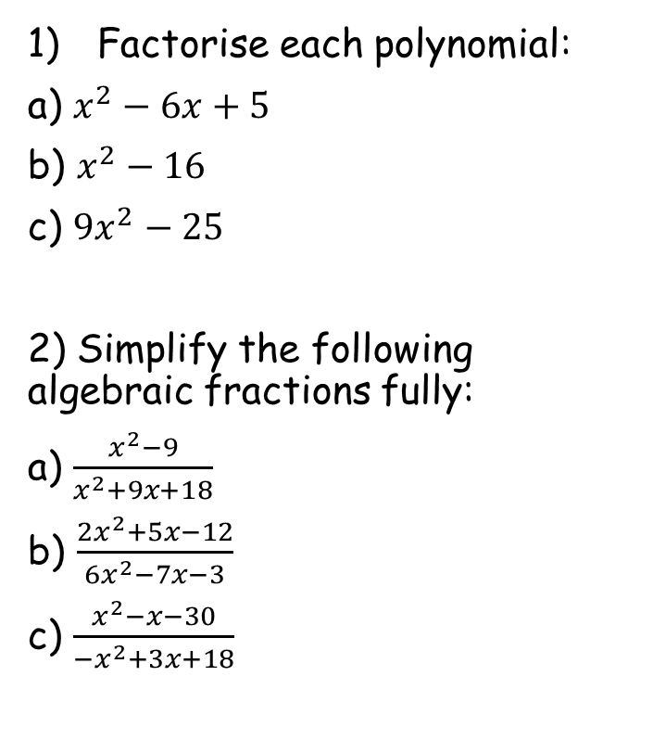






Prior Knowledge Check
Factorise each polynomial:
a) $x^{2}−6x+5$
b) $x^{2}−16$
c) ${9x}^{2}−25$
2) Simplify the following algebraic fractions fully:
a) $\frac{x^{2}−9}{x^{2}+9x+18}$
b) $\frac{{2x}^{2}+5x−12}{{6x}^{2}−7x−3}$
c) $\frac{x^{2}−x−30}{−x^{2}+3x+18}$
3) For any integers $n$ and $m$, decide whether the following will always be odd, always be even, or could be either:
a) $8n$
b) $n−m$
c) $3m$
d) $2n−5$
$$(x−1)(x−5)$$
$$(x+4)(x−4)$$
$$(3x−5)(3x+5)$$
$$Even$$
$$Either$$
$$Either$$
$$Odd$$
$$\frac{x−3}{x+6}$$
$$\frac{x+4}{3x+1}$$
$$−\frac{x+5}{x+3}$$

Slide 3
Teachings for Section 1A

Slide 4
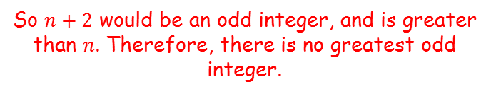




Algebraic Methods
You need to be able to prove statements by contradiction
To prove a statement by contradiction, you need to follow these steps:
Assume the statement is false
Use logical steps to show that this leads to an impossible outcome, or one that contradicts the original statement
The statement that shows the original assumption is false is known as the ‘negation’ of the statement
Prove by contradiction that there is no greatest odd integer
Assumption: There is a greatest odd integer, $n$
We need to use logical steps to reach a contradiction/impossibility
If $n$ is an integer, then $n+2$ is also an integer
$$n+2>n$$
$$n+2=odd+even$$
$=odd$
So $n+2$ would be an odd integer, and is greater than $n$. Therefore, there is no greatest odd integer.
1A

Slide 5
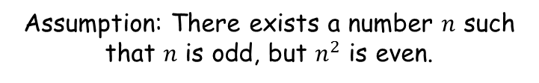
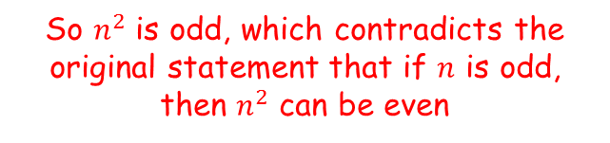
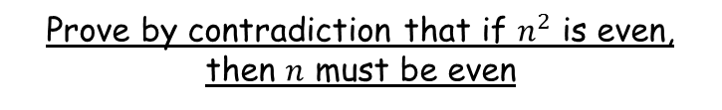


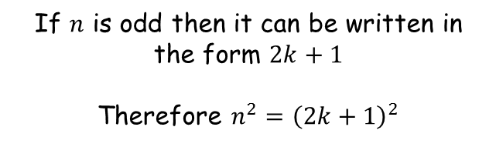
Algebraic Methods
You need to be able to prove statements by contradiction
To prove a statement by contradiction, you need to follow these steps:
Assume the statement is false
Use logical steps to show that this leads to an impossible outcome, or one that contradicts the original statement
The statement that shows the original assumption is false is known as the ‘negation’ of the statement
Prove by contradiction that if $n^{2}$ is even, then $n$ must be even
Assumption: There exists a number $n$ such that $n$ is odd, but $n^{2}$ is even.
We need to use logical steps to reach a contradiction/impossibility
If $n$ is odd then it can be written in the form $2k+1$
Therefore $n^{2}={\left(2k+1\right)}^{2}$
$$={4k}^{2}+4k+1$$
$$=2(2k^{2}+2k)+1$$
So $n^{2}$ is odd, which contradicts the original statement that if $n$ is odd, then $n^{2}$ can be even
1A

Slide 6


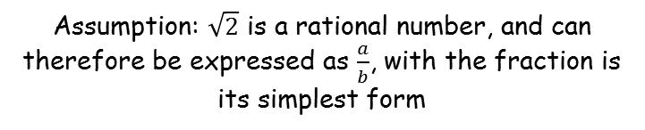


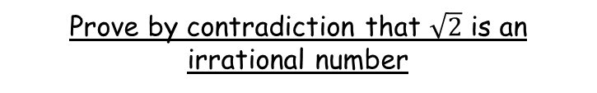

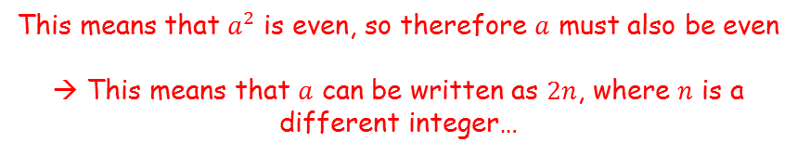




Algebraic Methods
You need to be able to prove statements by contradiction
To prove a statement by contradiction, you need to follow these steps:
Assume the statement is false
Use logical steps to show that this leads to an impossible outcome, or one that contradicts the original statement
The statement that shows the original assumption is false is known as the ‘negation’ of the statement
Prove by contradiction that $\sqrt{2}$ is an irrational number
Assumption: $\sqrt{2}$ is a rational number, and can therefore be expressed as $\frac{a}{b}$, with the fraction is its simplest form
We need to use logical steps to reach a contradiction/impossibility
$$\sqrt{2}=\frac{a}{b}$$
Square both sides
$$2=\frac{a^{2}}{b^{2}}$$
Multiply by $b^{2}$
$$2b^{2}=a^{2}$$
Replace $a$ with $2n$
$$2b^{2}={(2n)}^{2}$$
Square
$$2b^{2}={4n}^{2}$$
This means that $a^{2}$ is even, so therefore $a$ must also be even
→ This means that $a$ can be written as $2n$, where $n$ is a different integer…
This means that $b^{2}$ is also even, so therefore $b$ must also be even
Divide by 2
$$b^{2}={2n}^{2}$$
1A

Slide 7
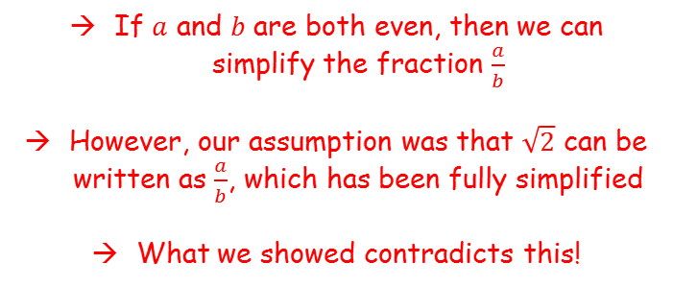

Algebraic Methods
You need to be able to prove statements by contradiction
To prove a statement by contradiction, you need to follow these steps:
Assume the statement is false
Use logical steps to show that this leads to an impossible outcome, or one that contradicts the original statement
The statement that shows the original assumption is false is known as the ‘negation’ of the statement
Prove by contradiction that $\sqrt{2}$ is an irrational number
Assumption: $\sqrt{2}$ is a rational number, and can therefore be expressed as $\frac{a}{b}$, with the fraction is its simplest form
We have just shown that $a$ and $b$ are both even – how does this contradict the original statement?
If $a$ and $b$ are both even, then we can simplify the fraction $\frac{a}{b}$
However, our assumption was that $\sqrt{2}$ can be written as $\frac{a}{b}$, which has been fully simplified
What we showed contradicts this!
Legend has it that Pythagoras believed that all roots can be written as rational numbers. A student proved otherwise, so he had the student killed!
1A

Slide 8




Algebraic Methods
You need to be able to prove statements by contradiction
To prove a statement by contradiction, you need to follow these steps:
Assume the statement is false
Use logical steps to show that this leads to an impossible outcome, or one that contradicts the original statement
The statement that shows the original assumption is false is known as the ‘negation’ of the statement
Prove by contradiction that there are infinitely many Prime numbers
Assumption: There is a finite number of Primes, with the largest being $p_{n}$
We need to use logical steps to reach a contradiction/impossibility
Imagine we listed all the prime numbers:
$$p_{1}, p_{2}, p_{3},…,…,…p_{n}$$
→ A number N will exist which is created by multiplying all the primes up to $p_{n}$, and then adding 1
$$p_{1}×p_{2}×p_{3},…,…×p_{n}$$
→ This number will not be divisible by any of the primes, since 1 has been added
→ Therefore, this number must either be Prime, or have a prime factor which was not on the original list
→ Either way, the statement has been contradicted!
1A

Slide 9
Teachings for Section 1B

Slide 10
Algebraic Methods
You need to be able to multiply and divide Algebraic Fractions
The rules for Algebraic versions are the same as for numerical versions
When multiplying Fractions, you multiply the Numerators together, and the Denominators together…
It is possible to simplify a sum before you work it out. This will be vital on harder Algebraic questions
Example Questions
a)
b)
c)
1B

Slide 11
Algebraic Methods
You need to be able to multiply and divide Algebraic Fractions
The rules for Algebraic versions are the same as for numerical versions
When multiplying Fractions, you multiply the Numerators together, and the Denominators together…
It is possible to simplify a sum before you work it out. This will be vital on harder Algebraic questions
Example Questions
1
d)
1
e)
Factorise
1
1
Multiply Numerator and Denominator
1B

Slide 12
Algebraic Methods
You need to be able to multiply and divide Algebraic Fractions
The rules for Algebraic versions are the same as for numerical versions
When multiplying Fractions, you multiply the Numerators together, and the Denominators together…
It is possible to simplify a sum before you work it out. This will be vital on harder Algebraic questions
When dividing Fractions, remember the rule, ‘Leave, Change and Flip’
→ Leave the first Fraction, change the sign to multiply, and flip the second Fraction.
Example Questions
a)
1B

Slide 13
Algebraic Methods
You need to be able to multiply and divide Algebraic Fractions
The rules for Algebraic versions are the same as for numerical versions
When multiplying Fractions, you multiply the Numerators together, and the Denominators together…
It is possible to simplify a sum before you work it out. This will be vital on harder Algebraic questions
When dividing Fractions, remember the rule, ‘Leave, Change and Flip’
→ Leave the first Fraction, change the sign to multiply, and flip the second Fraction.
Example Questions
b)
1
1
1B

Slide 14
Algebraic Methods
You need to be able to multiply and divide Algebraic Fractions
The rules for Algebraic versions are the same as for numerical versions
When multiplying Fractions, you multiply the Numerators together, and the Denominators together…
It is possible to simplify a sum before you work it out. This will be vital on harder Algebraic questions
When dividing Fractions, remember the rule, ‘Leave, Change and Flip’
→ Leave the first Fraction, change the sign to multiply, and flip the second Fraction.
Example Questions
c)
Leave, Change and Flip
Factorise
1
1
1
1
Multiply the Numerators and Denominators
1B

Slide 15
Teachings for Section 1C

Slide 16
Algebraic Methods
You need to be able to add and subtract Algebraic Fractions
The rules for Algebraic versions are the same as for numerical versions
When adding and subtracting fractions, they must first have the same Denominator. After that, you just add/subtract the Numerators.
Example Questions
a)
Multiply all by 4
Multiply all by 3
Add the Numerators
Add the Numerators
1C

Slide 17
Algebraic Methods
You need to be able to add and subtract Algebraic Fractions
The rules for Algebraic versions are the same as for numerical versions
When adding and subtracting fractions, they must first have the same Denominator. After that, you just add/subtract the Numerators.
Example Questions
Example Questions
b)
Imagine ‘b’ as a Fraction
Multiply all by x
Combine as a single Fraction
Combine as a single Fraction
1C

Slide 18
Algebraic Methods
You need to be able to add and subtract Algebraic Fractions
The rules for Algebraic versions are the same as for numerical versions
When adding and subtracting fractions, they must first have the same Denominator. After that, you just add/subtract the Numerators.
Example Questions
c)
Factorise so you can compare Denominators
Factorise so you can compare Denominators
Multiply by (x - 1)
Expand the bracket, and write as a single Fraction
Expand the bracket, and write as a single Fraction
Simplify the Numerator
Simplify the Numerator
1C

Slide 19
Teachings for Section 1D

Slide 20









Algebraic Methods
You can split a fraction with two linear factors into Partial Fractions
$$\frac{x−1}{(x+3)(x+1)}$$
$$\frac{2}{x+3}$$
$$\frac{1}{x+1}$$
For example:
$$=$$
$$−$$
when split up into Partial Fractions
$$\frac{11}{(x−3)(x+2)}$$
$$\frac{A}{x−3}$$
$$\frac{B}{x+2}$$
$$=$$
$$+$$
when split up into Partial Fractions
You need to be able to calculate the values of A and B…
1D

Slide 21








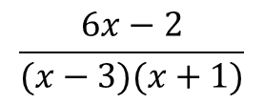














Algebraic Methods
You can split a fraction with two linear factors into Partial Fractions
$$\frac{6x−2}{(x−3)(x+1)}$$
Split the Fraction into its 2 linear parts, with numerators A and B
$$\frac{A}{(x−3)}$$
$$\frac{B}{(x+1)}$$
Split
$$+$$
Cross-multiply to make the denominators the same
$$\frac{6x−2}{(x−3)(x+1)}$$
$$\frac{A(x+1)}{(x−3)(x+1)}$$
$$\frac{B(x−3)}{(x−3)(x+1)}$$
$$+$$
Group together as one fraction
into Partial Fractions
$$= \frac{A\left(x+1\right)+B(x−3)}{(x−3)(x+1)}$$
This has the same denominator as the initial fraction, so the numerators must be the same
$$6x−2$$
$$=$$
$$A\left(x+1\right)+B(x−3)$$
If x = -1:
$$−8$$
$$=$$
$$−4B$$
$$2$$
$$=$$
$$B$$
If x = 3:
$$16$$
$$=$$
$$4A$$
$$4$$
$$=$$
$$A$$
You now have the values of A and B and can write the answer as Partial Fractions
$$= \frac{4}{(x−3)}$$
$$\frac{2}{(x+1)}$$
$$+$$
1D

Slide 22





























Algebraic Methods
$$\frac{6x^{2}+5x−2}{x(x−1)(2x+1)}$$
You can also split fractions with more than 2 linear factors in the denominator
Split the Fraction into its 3 linear parts
$$\frac{A}{x}$$
$$+$$
$$\frac{B}{x−1}$$
$$+$$
$$\frac{C}{2x+1}$$
Split
Cross Multiply to make the denominators equal
$$\frac{6x^{2}+5x−2}{x(x−1)(2x+1)}$$
$$\frac{A(x−1)(2x+1)}{x(x−1)(2x+1)}$$
$$\frac{B(x)(2x+1)}{x(x−1)(2x+1)}$$
$$\frac{C(x)(x−1)}{x(x−1)(2x+1)}$$
$$+$$
$$+$$
Put the fractions together
into Partial fractions
$$\frac{A\left(x−1\right)\left(2x+1\right)+B\left(x\right)\left(2x+1\right)+C(x)(x−1)}{x(x−1)(2x+1)}$$
The numerators must be equal
$$6x^{2}+5x−2$$
$$=$$
$$A\left(x−1\right)\left(2x+1\right)+B\left(x\right)\left(2x+1\right)+C(x)(x−1)$$
If x = 1
$$9$$
$$=$$
3$B$
$$3$$
$$=$$
$$B$$
If x = 0
$$−2$$
$$=$$
$$−A$$
$$2$$
$$=$$
$$A$$
If x = -0.5
$$−3$$
$$=$$
$$0.75C$$
$$−4$$
$$=$$
$$C$$
You can now fill in the numerators
$$=$$
$$\frac{2}{x}$$
$$+$$
$$\frac{3}{x−1}$$
$$−$$
$$\frac{4}{2x+1}$$
1D

Slide 23
Teachings for Section 1E

Slide 24





Algebraic Methods
You need to be able to split a fraction that has repeated linear roots into a Partial Fraction
$$\frac{3x^{2}−4x+2}{\left(x+1\right)(x−5)^{2}}$$
$$\frac{A}{(x+1)}$$
$$\frac{B}{(x−5)}$$
$$\frac{C}{(x−5)^{2}}$$
when split up into Partial Fractions
For example:
$$=$$
$$+$$
$$+$$
The repeated root is included once ‘fully’ and once ‘broken down’
1E

Slide 25





























Algebraic Methods
$$\frac{11x^{2}+14x+5}{(x+1)^{2}(2x+1)}$$
You need to be able to split a fraction that has repeated linear roots into a Partial Fraction
Split the fraction into its 3 parts
$$\frac{A}{(x+1)}$$
$$+$$
$$\frac{B}{(x+1)^{2}}$$
$$+$$
$$\frac{C}{(2x+1)}$$
Split
Make the denominators equivalent
$$\frac{11x^{2}+14x+5}{(x+1)^{2}(2x+1)}$$
$$\frac{A(x+1)(2x+1)}{(x+1)^{2}(2x+1)}$$
$$\frac{B(2x+1)}{(x+1)^{2}(2x+1)}$$
$$\frac{C(x+1)^{2}}{(x+1)^{2}(2x+1)}$$
$$+$$
$$+$$
Group up
into Partial fractions
$$=\frac{A\left(x+1\right)\left(2x+1\right)+B\left(2x+1\right)+C(x+1)^{2}}{(x+1)^{2}(2x+1)}$$
The numerators will be the same
$$11x^{2}+14x+5$$
$$=$$
$$A\left(x+1\right)\left(2x+1\right)+B\left(2x+1\right)+C(x+1)^{2}$$
If x = -1
$$2$$
$$=$$
$$−B$$
$$−2$$
$$=$$
$$B$$
If x = -0.5
$$0.75$$
$$=$$
$$0.25C$$
At this point there is no way to cancel B and C to leave A by substituting a value in
$$3$$
$$=$$
$$C$$
If x = 0
$$5$$
$$=$$
$$1A$$
$$+$$
$$1B$$
$$+$$
$1$C
$$5$$
Choose any value for x (that hasn’t been used yet), and use the values you know for B and C to leave A
$$=$$
$$A$$
$$−$$
$$2$$
$$+$$
3
$$4$$
$$=$$
$$A$$
Sub in the values of A, B and C
$$=$$
$$\frac{4}{(x+1)}$$
$$−$$
$$\frac{2}{(x+1)^{2}}$$
$$+$$
$$\frac{3}{(2x+1)}$$
1E

Slide 26
Teachings for Section 1F

Slide 27


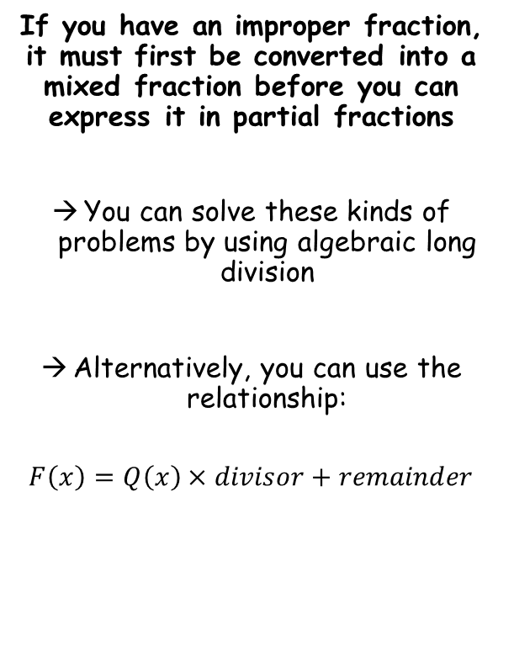







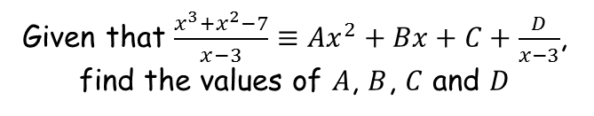





Algebraic Methods
Given that $\frac{x^{3}+x^{2}−7}{x−3}≡{Ax}^{2}+Bx+C+\frac{D}{x−3}$, find the values of $A$, $B$, $C$ and $D$
If you have an improper fraction, it must first be converted into a mixed fraction before you can express it in partial fractions
You can solve these kinds of problems by using algebraic long division
Alternatively, you can use the relationship:
$$F\left(x\right)=Q\left(x\right)×divisor+remainder$$
$$x^{2}$$
$$+ 4x$$
$$+ 12$$
$$x−3$$
$$x^{3}+x^{2}+0x−7$$
Using algebraic long division
$$x^{3}−3x^{2}$$
$${4x}^{2}+0x−7$$
$${4x}^{2}−12x$$
$$12x−7$$
$$12x−36$$
$$29$$
$$\frac{x^{3}+x^{2}−7}{x−3}≡x^{2}+4x+12 remainder 29$$
$$37=12 × 3 + 1$$
Write the remainder over the divisor (as you would if dividing with numbers)
$$\frac{x^{3}+x^{2}−7}{x−3}≡x^{2}+4x+12+\frac{29}{x−3}$$
1F

Slide 28


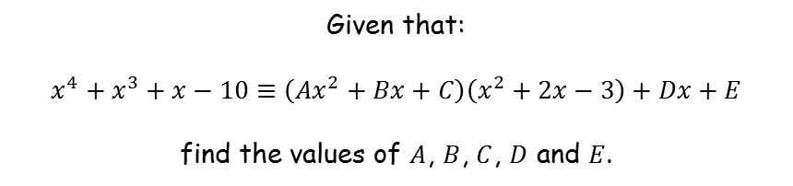












Algebraic Methods
Given that:
$$x^{4}+x^{3}+x−10≡\left({Ax}^{2}+Bx+C\right)\left(x^{2}+2x−3\right)+Dx+E$$
find the values of $A$, $B$, $C$, $D$ and $E$.
If you have an improper fraction, it must first be converted into a mixed fraction before you can express it in partial fractions
You can solve these kinds of problems by using algebraic long division
Alternatively, you can use the relationship:
$$F\left(x\right)=Q\left(x\right)×divisor+remainder$$
Compare $x^{4}$ terms
Compare $x^{3}$ terms
$$x^{4}=Ax^{4}$$
$$x^{3}=2x^{3}+Bx^{3}$$
$$A=1$$
$$B=−1$$
Updated relationship
$$x^{4}+x^{3}+x−10≡\left(x^{2}+Bx+C\right)\left(x^{2}+2x−3\right)+Dx+E$$
$$x^{4}+x^{3}+x−10≡\left(x^{2}−x+5\right)\left(x^{2}+2x−3\right)+Dx+E$$
$$x^{4}+x^{3}+x−10≡\left(x^{2}−x+C\right)\left(x^{2}+2x−3\right)+Dx+E$$
$$x^{4}+x^{3}+x−10≡\left(x^{2}−x+5\right)\left(x^{2}+2x−3\right)−12x+5$$
$$x^{4}+x^{3}+x−10≡\left(x^{2}−x+5\right)\left(x^{2}+2x−3\right)−12x+E$$
Compare $x^{2}$ terms
Compare $x$ terms
$${0x}^{2}=Cx^{2}−3x^{2}−2x^{2}$$
$$x=3x+10x+Dx$$
$$C=5$$
$$D=−12$$
Compare constant
$$−10=−15+E$$
$$E=5$$
1F

Slide 29
Teachings for Section 1G

Slide 30












Algebraic Methods
You can split an improper fraction into Partial Fractions. You will need to divide the numerator by the denominator first to find the ‘whole’ part
A regular fraction being split into 2 ‘components’
$$\frac{22}{35}$$
$$\frac{1}{5}$$
$$\frac{3}{7}$$
$$=$$
$$+$$
$$\frac{57}{20}$$
$$\frac{1}{4}$$
$$\frac{3}{5}$$
$$=$$
$$2$$
$$+$$
$$+$$
A top heavy (improper) fraction will have a ‘whole number part before the fractions
1G

Slide 31





















Algebraic Methods
$$\frac{3x^{2}−3x−2}{(x−1)(x−2)}$$
$$=$$
$$\frac{3x^{2}−3x−2}{x^{2}−3x+2}$$
You can split an improper fraction into Partial Fractions. You will need to divide the numerator by the denominator first to find the ‘whole’ part
Divide the numerator by the denominator to find the ‘whole’ part
$$3$$
$$x^{2}−3x+2$$
$${3x}^{2}−3x−2$$
Split
$${3x}^{2}−9x+6$$
$$\frac{3x^{2}−3x−2}{(x−1)(x−2)}$$
$$6x−8$$
Now rewrite the original fraction with the whole part taken out
$$\frac{3x^{2}−3x−2}{(x−1)(x−2)}$$
$$=$$
$$3 +$$
$$\frac{6x−8}{(x−1)(x−2)}$$
into Partial fractions
Split the fraction into 2 parts (ignore the whole part for now)
Remember, Algebraically an ‘improper’ fraction is one where the degree (power) of the numerator is equal to or exceeds that of the denominator
$$\frac{A}{(x−1)}$$
$$+$$
$$\frac{B}{(x−2)}$$
Make denominators equivalent and group up
$$=\frac{A\left(x−2\right)+B(x−1)}{(x−1)(x−2)}$$
The numerators will be the same
$$6x−8$$
$$=$$
$$A\left(x−2\right)+B(x−1)$$
If x = 2
$$4$$
$$=$$
$$B$$
If x = 1
$$−2$$
$$=$$
$$−A$$
$$2$$
$$=$$
$$A$$
$$= 3 +$$
$$\frac{2}{(x−1)}$$
$$+$$
$$\frac{4}{(x−2)}$$
1G

